Slide 1
Exploring the Endless Frontier: Science Policy for the Planetary Scientist
Sam Myers
Ph.D. Candidate, LPL, University of Arizona
^{LPLC Invited Graduate Speaker}
^{August 18/19, 2023}
Image Credit: Unknown
Notes:
Why policy is something we all should care about
There are ways to get involved in science policy

Slide 2
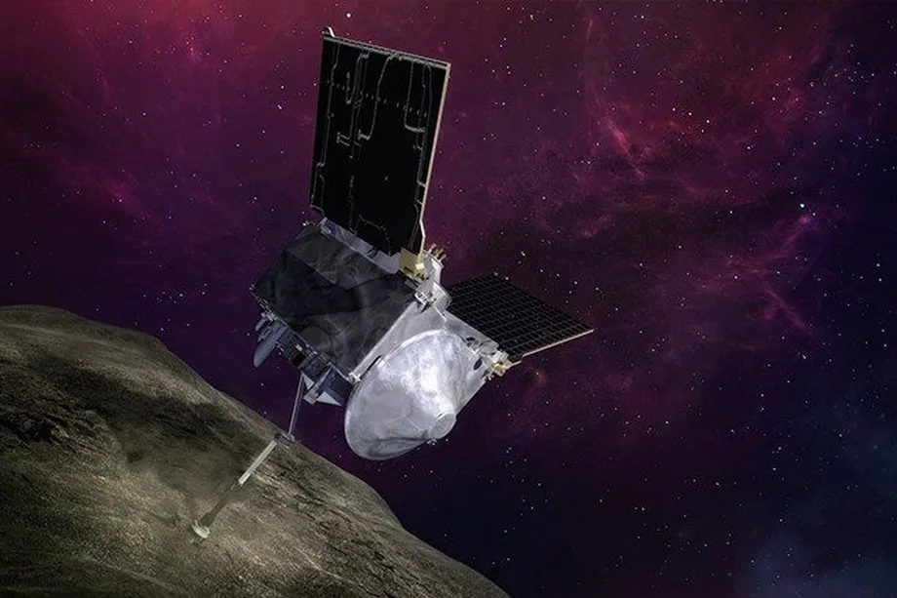
What is science policy?
Science for Policy
Policy for Science
Sam Myers – University of Arizona
Image Credits: ME Newman/John Hopkins; iStock; NSF; NASA/The Verge
1
Notes:
Science for Policy: Using science to advance public policy
Policy for Science: Using policy to advance science

Slide 3
Why Policy Matters to Planetary Science
Funding
Data acquisition
Archiving
Institutional support
Education and recruitment
Planetary defense
Planetary protection
Sam Myers – University of Arizona
2
Notes:
Ways policy affects us as planetary scientists

Slide 4
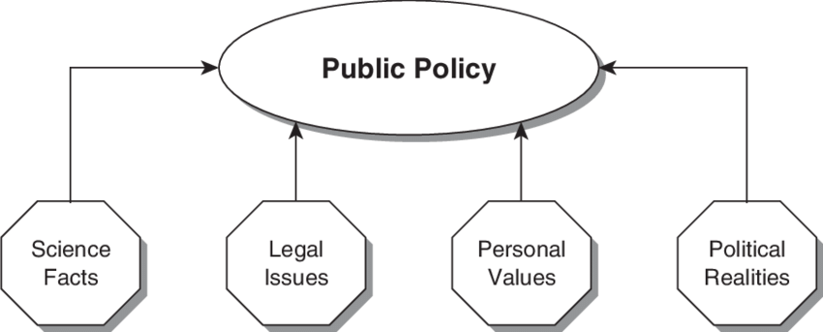
Why You Should Care
Science does influence policy
Congress does care what
their constituents think
Image Credit: Gentile & Anderson, 2009
Image Credit: Congressional Management Foundation
Sam Myers – University of Arizona
3

Slide 5
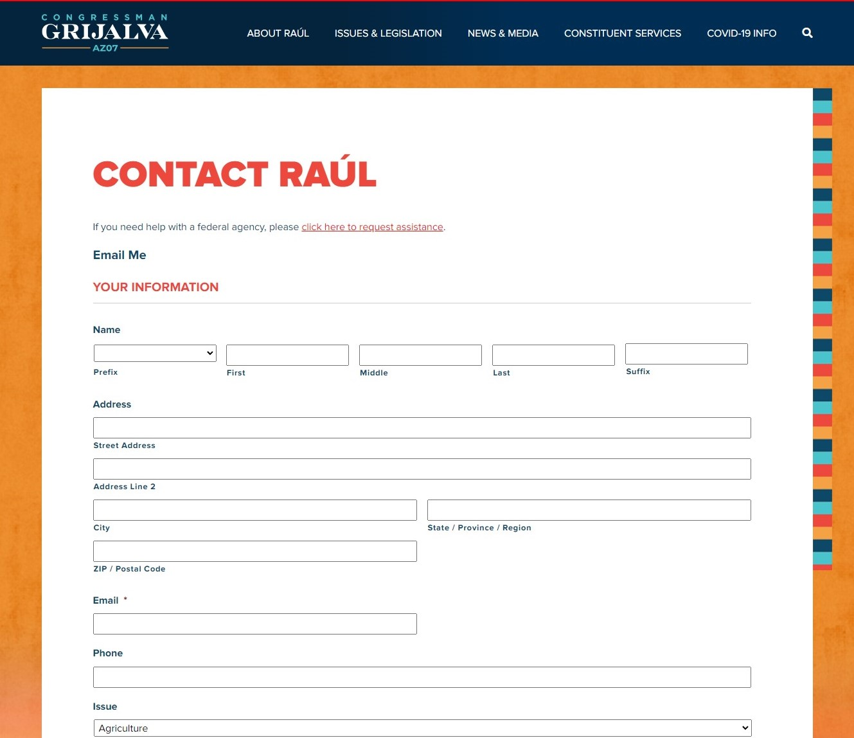
How to Get Involved: Contacting your Members of Congress
Find my Member of Congress: https://www.congress.gov/members/find-your-member
Phone, Email, Website
University Federal Relations
Sam Myers – University of Arizona
4

Slide 6
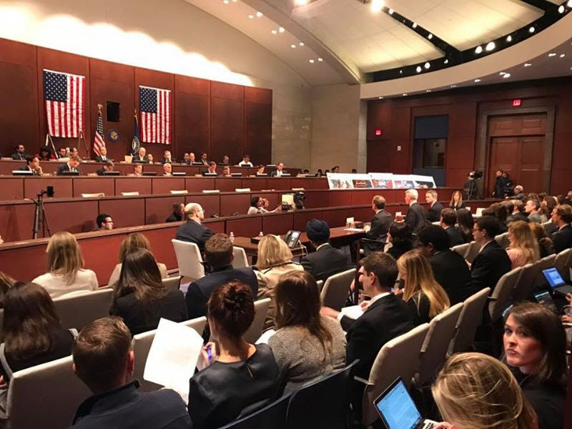
How to Get Involved: What to Expect in a Meeting
Zoom, Teams, or Phone
Short (15-30 mins max)
Staffers
You’re in charge
Have a simple ask
Align your message
Follow up
Focus on your expertise
You speak for yourself, not the University!
Sam Myers – University of Arizona
Image Credits: House Press Gallery; Pitzer College
5
Notes:
Meetings are friendly, conversational, and informal
Ask them to do something specific, like sign a letter or vote for a bill
Do research on what the member cares about and align your message to their interests
Make it clear you represent yourself, not your institution or NASA mission

Slide 7
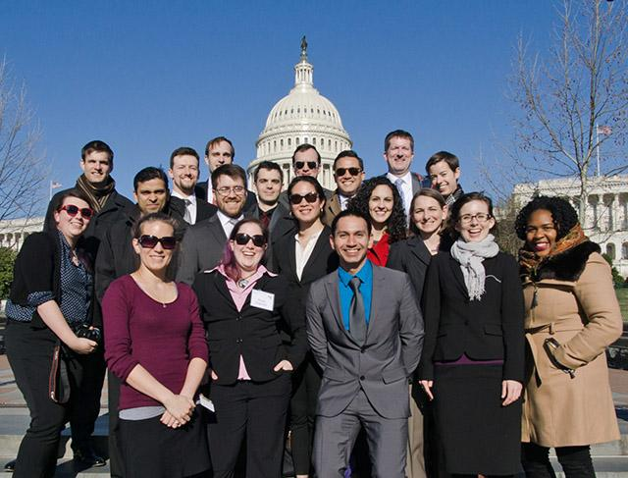
How to Get Involved: Congressional Action Days
American Astronomical Society (AAS)
American Geophysical Union (AGU)
Planetary Society
AAS CVD 2017
Sam Myers – University of Arizona
Image Credits: AAS
6

Slide 8
How to Get Involved: Astronomy and Planetary Science
Decadal Surveys
NASA Advisory Committees and “AG”s
DPS Federal Relations Subcommittee
Sam Myers – University of Arizona
Image Credits: NASEM; NASA
7

Slide 9
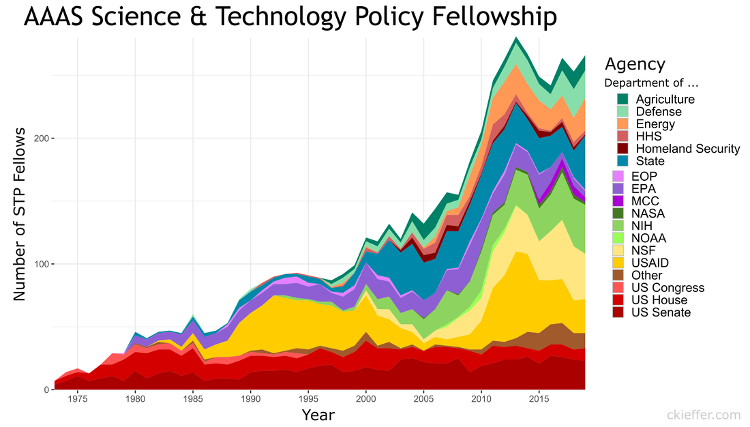
How to Get Involved: Other Organizations
AAAS Science & Technology Policy Fellowship
AGU Voices for Science
AGU Local Science Partners
Union of Concerned Scientists
University of Arizona
250
200
150
100
50
1975
2015
Image Credit: CM Kieffer
Sam Myers – University of Arizona
8

Slide 10
Summary
Thank You!
Your voice can matter!
There are lots of ways to get involved!
Questions?
Find my Member of Congress | https://www.congress.gov/members/find-your-member
AAS Advocacy Tips | https://aas.org/advocacy/get-involved
DPS Federal Relations Subcommittee | https://dps.aas.org/leadership/frs
University of Arizona Federal Relations | https://gcr.arizona.edu/federal
University of Arizona Lobbying Rules | https://policy.arizona.edu/ethics-and-conduct/political-activity-and-lobbying-policy-interim#policy
AAAS STPF | https://www.aaas.org/programs/science-technology-policy-fellowships
AGU Policy Opportunities | https://www.agu.org/Share-and-Advocate/Share/Policymakers/Opportunities
University of Arizona Science Policy Class | https://ce.arizona.edu/classes/science-policy-and-diplomacy
Sam Myers – University of Arizona
sammyers@arizona.edu
9

Slide 11
What is science policy?
Sam Myers – University of Arizona
S1
Notes:
Founding document of modern science policy

Slide 12
Why You Should Care
Image Credit: NSF
Sam Myers – University of Arizona
S2
Notes:
NSF Broader Impacts that overlap with science policy involvement

Slide 13
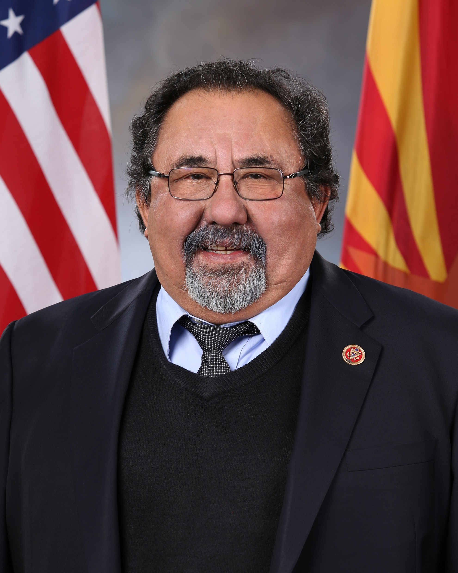
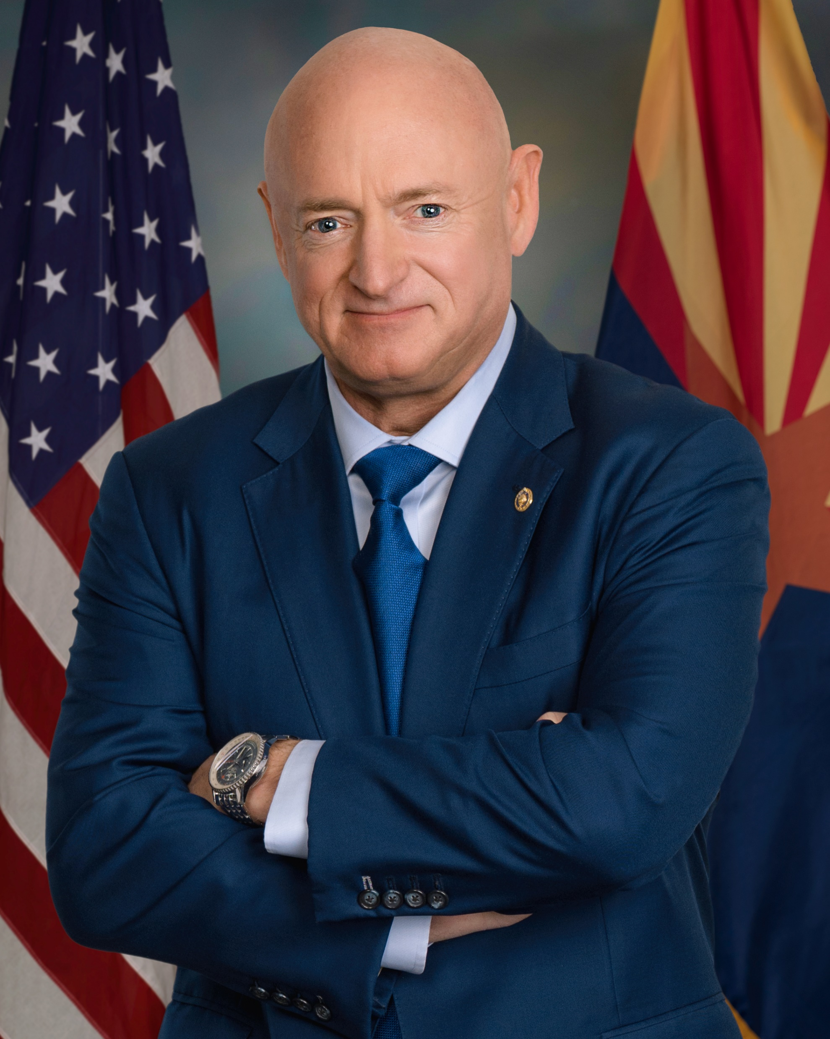
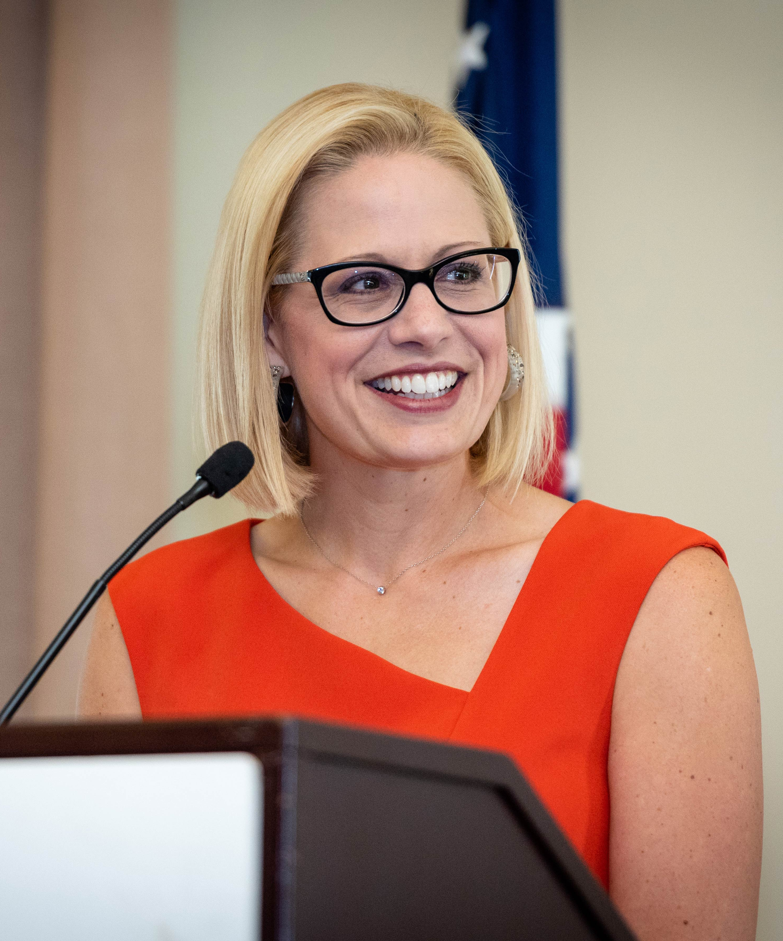
How to Get Involved: Contacting your Members of Congress
Raúl Grijalva (D)
Mark Kelly (D)
Kyrsten Sinema (I)
House
Senate
Find my Member of Congress: https://www.congress.gov/members/find-your-member
Sam Myers – University of Arizona
Image Credits: Justice Democrats, US Senate
S3
Notes:
Members of Congress that represent LPLs district

